Slide 1
CSE 1207
Software and its classification

Slide 2
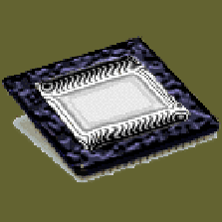
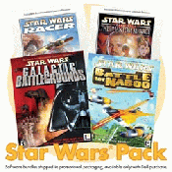
Parts of a Computer
There are two basic parts that make up a computer...
Hardware
Software

Slide 3
Hardware
Hardware is basically anything that you can touch with your fingers.
Computer Case
CPU (central processing unit...Pentium chip)
Monitor
Keyboard & Mouse
Disk Drive, Zip Drive, CD-ROM, DVD,
Hard Drive
Memory (RAM)
Speakers
Printer

Slide 4
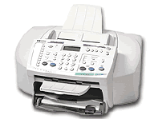
Hardware (Continued)
There are three types/categories of hardware
1. Input Devices
2. Output Devices
3. Storage Devices

Slide 5
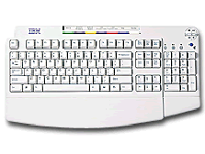
Input Devices
Input basically means getting data into the computer to be processed.
Keyboard, Mouse,
Trackball, Touch Pad
Light Pen, Laser Scanner,
Pointing Stick
Touch Screen,
Bar Code Reader, Scanner
Microphone, Joystick

Slide 6
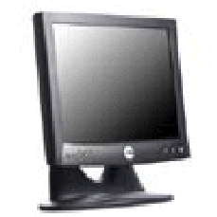
Output Devices
Output basically means getting data out of the computer.
Monitor
Printer
Speakers
Headphones
Modem
Fax

Slide 7
Storage Devices
Storage devices are both input and output devices in one. A storage device is a place to keep data that has been processed so that it can be retrieved at a later time to be used again.
Hard Disk
Floppy Disk
CD’s, DVD’s
Magnetic Tape
Flash Memory, Jump Drive

Slide 8
Software
Software is the programs and applications that tell the computer what to do and how to look.
Computer programmers write the codes/instructions that make-up software applications/programs.
HTML is a type of computer programming language that allows programmers to make web pages.
The next 2 slides show what HTML codes look like and the web page the codes produce.

Slide 9
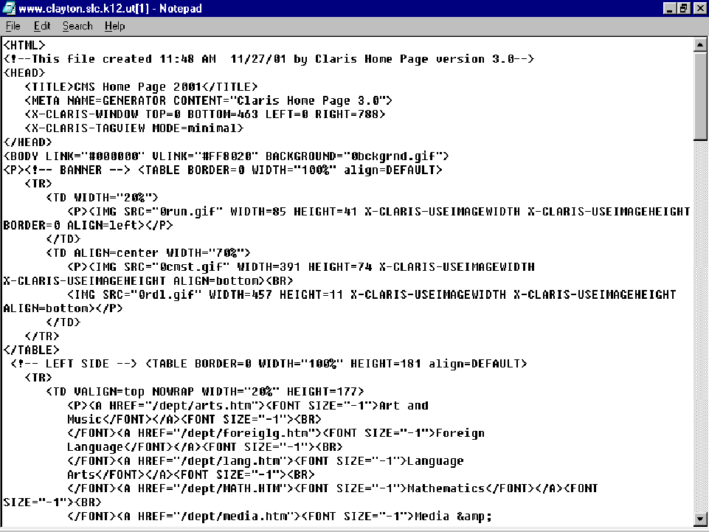

Slide 10
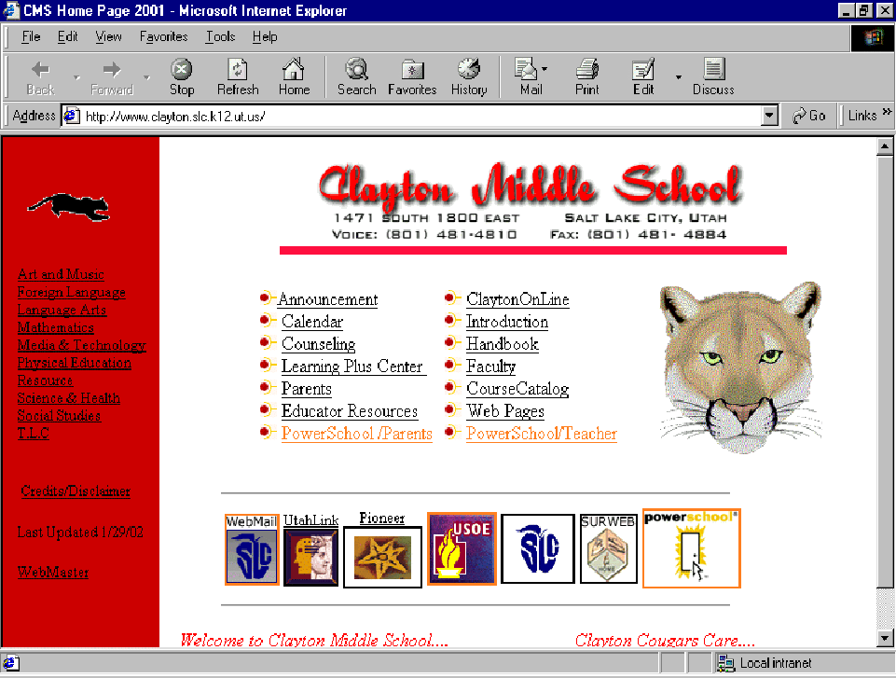

Slide 11
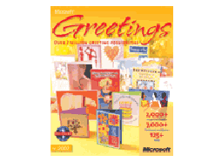
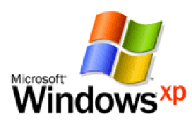
Two Types of Software
Application Software
Operating System Software

Slide 12
Operating System Software
Directs all the activities and sets all the rules for how the hardware and software will work together.
Examples would be:
DOS, Windows 95, 98, ME, NT, XP, Vista, Windows 7
Unix, Linux,
MAC system OS 6,7,8,9,10

Slide 13
Command Line Operating Systems
DOS is an example of a command line operating system.
On the next slide, Notice that there are no:
Icons (pictures)
Colors
Mouse Pointer
Buttons
You have to memorize commands in order to use this text based operating system.

Slide 14
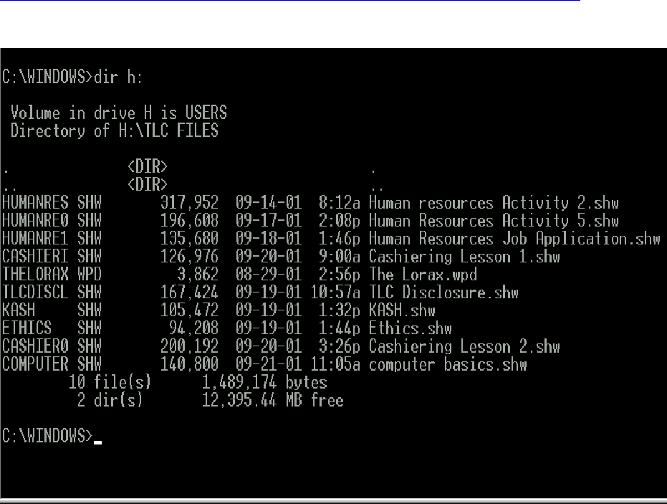

Slide 15
Operating Systems: GUI
GUI stands for Graphical User Interface
Uses pictures (icons) to represent files, folders, disk drives, modems, printers, etc.
GUI’s were created to make using a computer easier, more interesting, non-threatening to inexperienced users.
A mouse allows users to point at something and click to make it work. With command line you have to have all of the commands to make your programs work.
Here is an example of a GUI

Slide 16
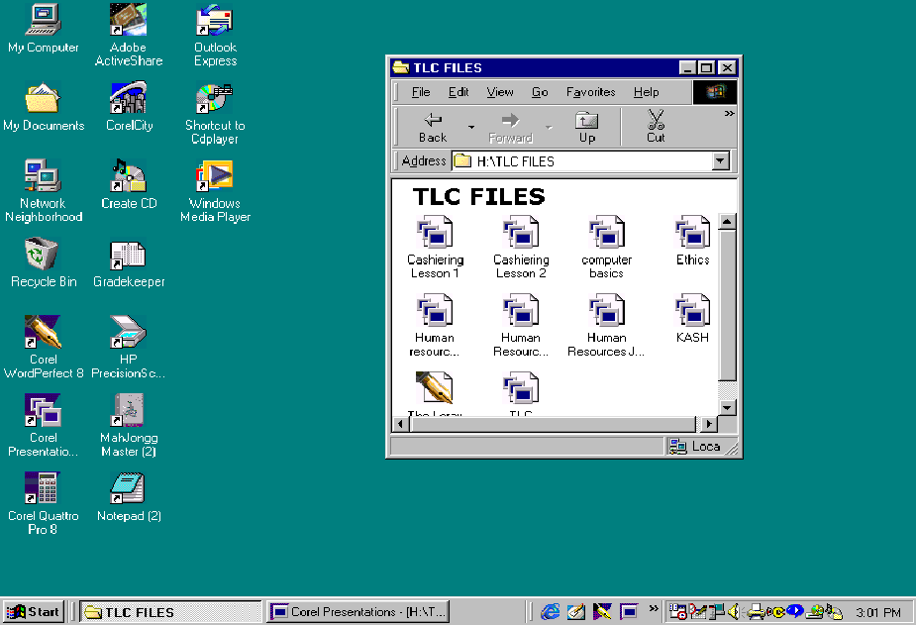

Slide 17
Application Software
Programs that work with operating system software to help the computer to do specific types of work.

Slide 18
Application Software
There are six basic types of application software...

Slide 19
Application Software
1. Business software: word processors, spreadsheets, and database programs.
2. Communication software: allows computers to communicate with other computers: fax software, Novell NetWare, AOL, Modem Software.
3. Graphics software: software that allows users to create and manipulate graphics...Photoshop, Print Shop, etc.

Slide 20
Application Software
4. Education and Reference software: Programs that help teach new material and ideas, and programs that can be used to find information...Encarta, Worldbook Encyclopedia, Jumpstart Kindergarten, MicroType.
5. Entertainment and Leisure software...Warcraft, Age of Empires, Barbie Design Center, Mrs. Pacman, Solitair
6. Integrated software: Combines several types of software into one program or package...Quicken (Spreadsheet/data base/communications/reference) or Print Shop (Graphics/Word processor).

Slide 21

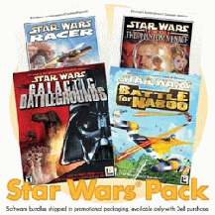

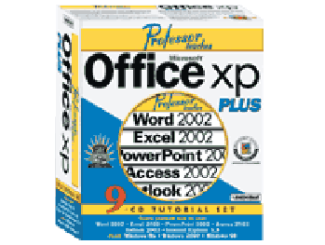
Software

Slide 22
Thank you

